Slide 1

SALARY RANGE PREDICTION
By: ARIES DIMAANO

Slide 2

Introduction
The goal of this project is to develop a predictive model that accurately estimates the minimum and maximum salary ranges for job listings. By leveraging historical job data and integrating Natural Language Processing (NLP) techniques, the project aims to enhance salary prediction accuracy. This model is designed to support employers in setting competitive salary offers, assist job seekers in understanding salary expectations, and optimize recruitment strategies by providing data-driven insights. The ultimate outcome is a robust and interpretable salary prediction model that aids in informed decision-making for talent management.

Slide 3
Objectives
Enhanced Recruitment Process:
By accurately predicting salary ranges, recruiters can better align job postings with market standards, attracting top-tier talent while optimizing hiring costs.
Improved Candidate Experience:
Providing transparent salary expectations upfront can significantly enhance candidate engagement and satisfaction, leading to higher acceptance rates.
Strategic Decision-Making:
Access to reliable salary forecasts empowers HR professionals and organizational leaders to make informed decisions regarding budget allocation and resource planning.

Slide 4
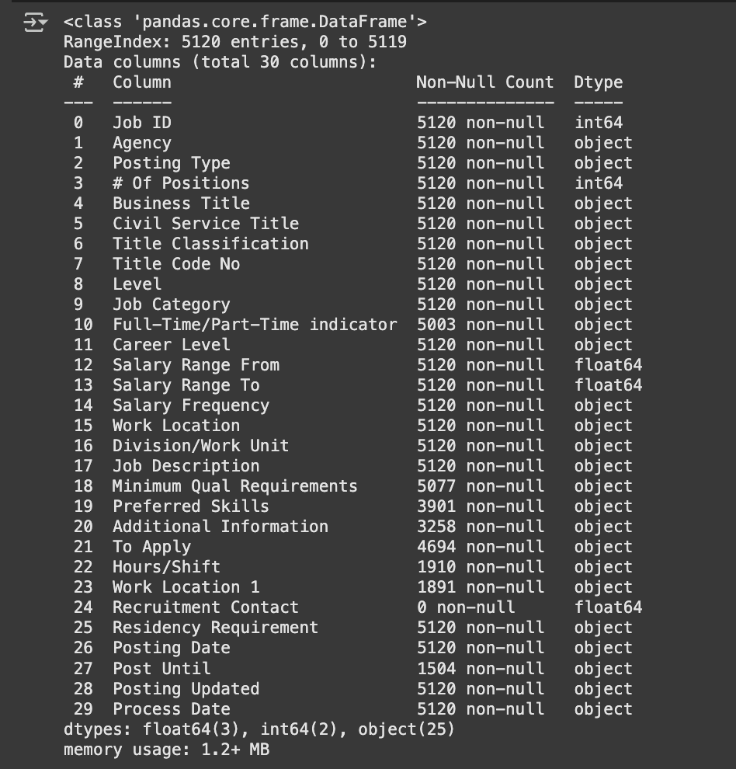
Data Overview
The dataset contains job listing in New York City, USA from 2020 to 2024 with the following columns:
The dataset’s features contains numerical columns like the target feature, Salary range From and To, while most of the features contains text and categorical features like Job Description and Job Category.

Slide 5
Data Cleaning and Prepocessing
Handle Missing Values and drop duplicates.
Unify target feature format
Drop columns that are unnecessary and have too much missing values.
Extract Experience in the Job Description
Use encoding methods to Categorical features

Slide 6
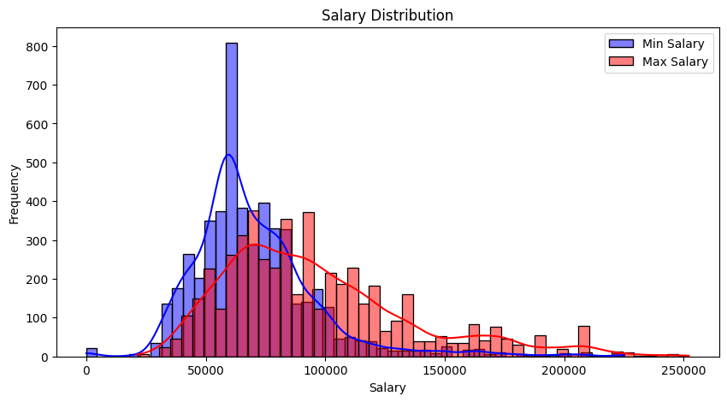
Exploratory Data Analysis
Salary Range Distribution

Slide 7
Exploratory Data Analysis
The salary distribution plot shows the frequency of minimum (blue) and maximum (red) salaries across job listings. Both distributions are right-skewed, with most of minimum salaries concentrated between $40,000 to $80,000, peaking around $60,000. In contrast, maximum salaries are more spread out, with a peak around $80,000 and extending beyond $200,000. The wider spread in maximum salaries suggests greater variability, possibly influenced by job level, industry, or experience requirements. This distribution highlights the importance of transforming the data or addressing outliers to improve model performance.

Slide 8
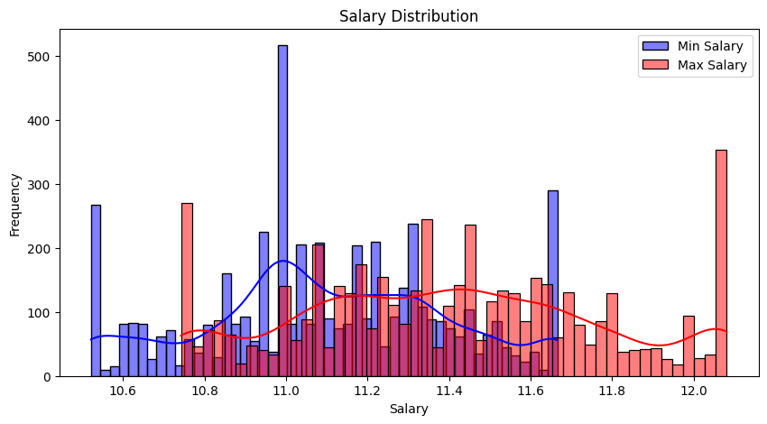
Exploratory Data Analysis
Salary Range Distribution after Winsorization and Log transform

Slide 9
Exploratory Data Analysis
After applying Winsorization and Log Transformation, the salary distribution has become more uniform and less skewed. The extreme outliers have been mitigated, resulting in a smoother distribution. Both minimum and maximum salaries now show a more consistent spread, enhancing model stability and reducing the impact of extreme values. This transformation helps in improving the performance of machine learning models by stabilizing variance and reducing skewness.

Slide 10
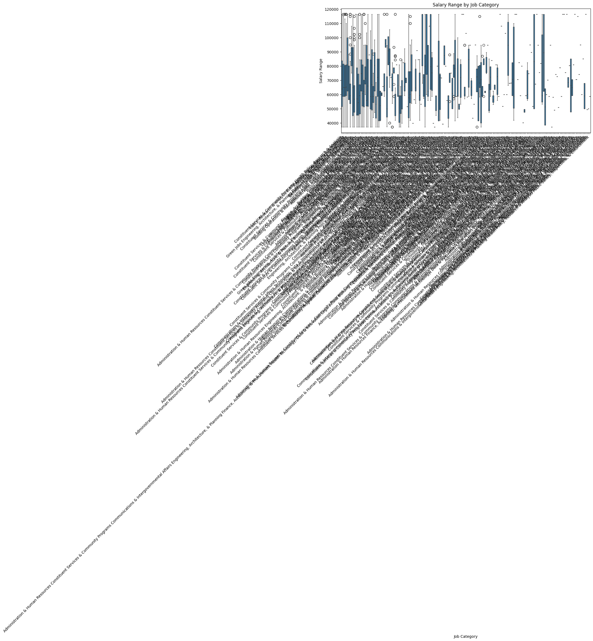
Exploratory Data Analysis
Box Plots for Salary by Job Category

Slide 11
Exploratory Data Analysis
The box plot shows significant variation in salary ranges across different job categories. Some categories exhibit wider salary ranges and more outliers, indicating diverse roles and experience levels within those categories. Others have narrower ranges, suggesting more standardized pay structures.

Slide 12
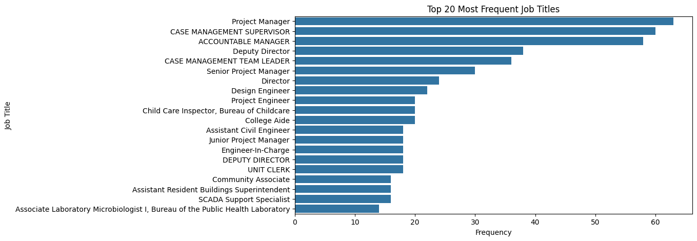
Exploratory Data Analysis
Bar chart for Job Title Frequency

Slide 13
Exploratory Data Analysis
The bar chart highlights the top 20 most frequent job titles. "Project Manager" appears most frequently, followed closely by "Case Management Supervisor" and "Accountable Manager". Roles related to project management and supervisory positions dominate the list, suggesting a higher demand for leadership and managerial roles. This distribution provides valuable insights for focusing predictive efforts on the most common job titles.

Slide 14
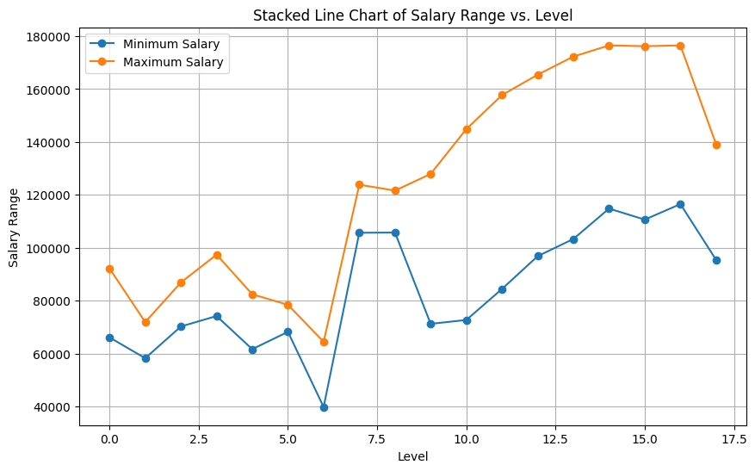
Exploratory Data Analysis

Slide 15
Exploratory Data Analysis
The stacked line chart shows a clear positive correlation between job level and salary range. As the level increases, both minimum and maximum salaries generally rise, indicating that higher levels are associated with higher pay. A significant jump in salaries is observed between levels 6 and 7, suggesting a possible promotion or role transition point. The maximum salary line consistently stays above the minimum, highlighting the widening salary gap at higher levels.

Slide 16
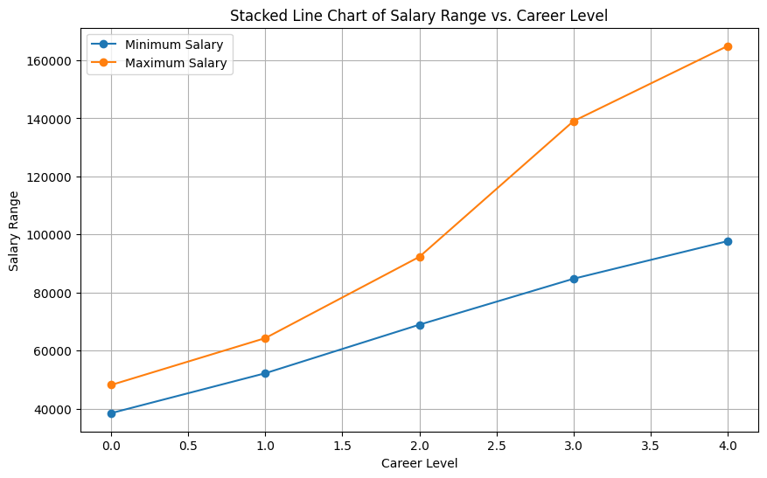
Exploratory Data Analysis

Slide 17
Exploratory Data Analysis
The stacked line chart shows a clear upward trend in both minimum and maximum salaries as career levels progress. Each increase in career level corresponds to a notable rise in salary, with the gap between minimum and maximum salaries widening at higher levels. This indicates that advancing through career levels offers greater earning potential and variability, emphasizing the value of career progression in achieving higher salary ranges.

Slide 18
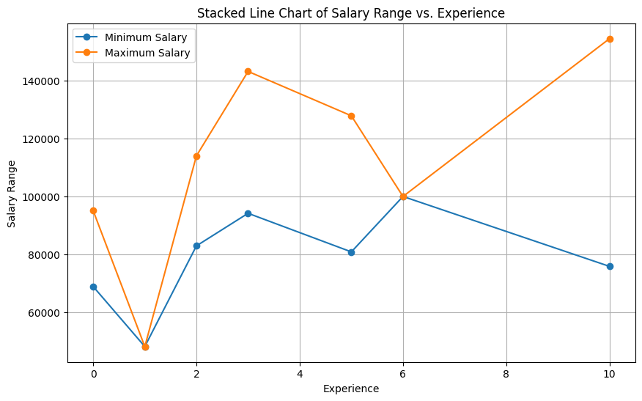
Exploratory Data Analysis

Slide 19
Exploratory Data Analysis
The stacked line chart shows an overall increasing trend in salary with experience, though with some fluctuations. Both minimum and maximum salaries drop at 1 year of experience but steadily rise afterward, peaking around 3-6 years. The maximum salary range shows a sharper increase, particularly for those with 10 years of experience, indicating higher earning potential for seasoned professionals. However, the decline in minimum salary for higher experience levels suggests variability in job roles or negotiation factors.

Slide 20
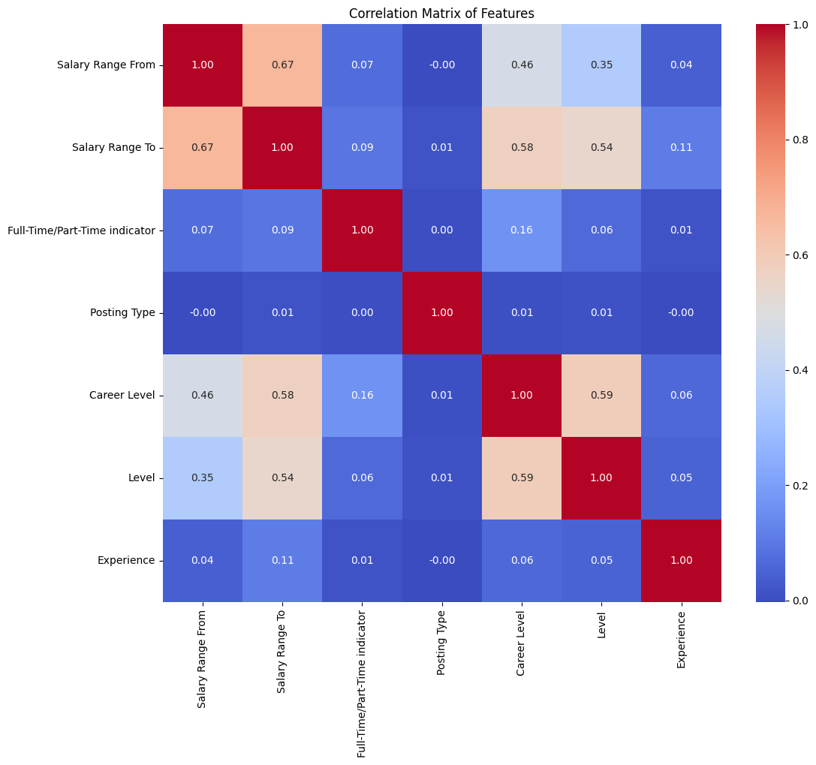
Exploratory Data Analysis

Slide 21
Exploratory Data Analysis
The correlation matrix shows a strong positive correlation (0.67) between 'Salary Range From' and 'Salary Range To', indicating that as minimum salaries increase, maximum salaries tend to rise as well. Career Level and Level are moderately correlated with salary ranges (correlations between 0.35 to 0.58), suggesting their importance in salary prediction. However, Experience shows weak correlations with salaries and other features, indicating it may have less influence or require further feature engineering. Features like 'Posting Type' and 'Full-Time/Part-Time Indicator' exhibit negligible correlations with salary, suggesting a limited direct impact.

Slide 22
Feature Engineering
Use Natural Language Processing
Combine and clean text-based features
Feature Extraction
(Convert Text to Numerical Data with Word2Vec)
Flatten and concatenate Word Embeddings
Polynomial Interactions
Split Data into Train & Test Sets

Slide 23
Model Training
Linear Regression
RandomForest Regression (Basic and with Hyperparameter Tuning)
XGBoost Regression (Basic and with Hyperparameter Tuning)
MLP Regression
Deep Learning Model

Slide 24
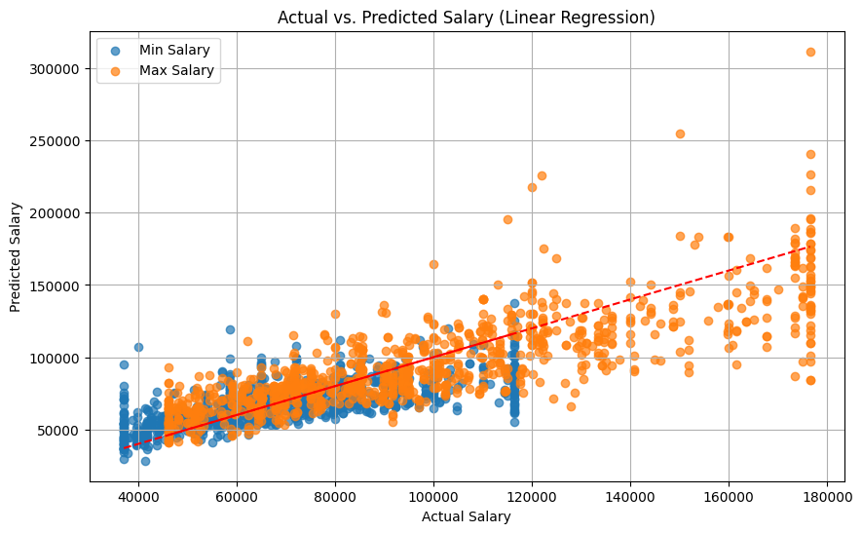
Linear Regression
RMSE: 18691.33
R² : 0.56

Slide 25
Linear Regression
The Linear Regression model achieved an RMSE of 18,691.33 and an R² of 0.56, indicating moderate predictive performance. While the model captures the general trend, the scatter of points around the regression line suggests significant variance and prediction errors, especially for higher salary ranges. This indicates that the linear model may struggle to capture complex, non-linear relationships in the data, suggesting the need for a more sophisticated model to improve accuracy.

Slide 26
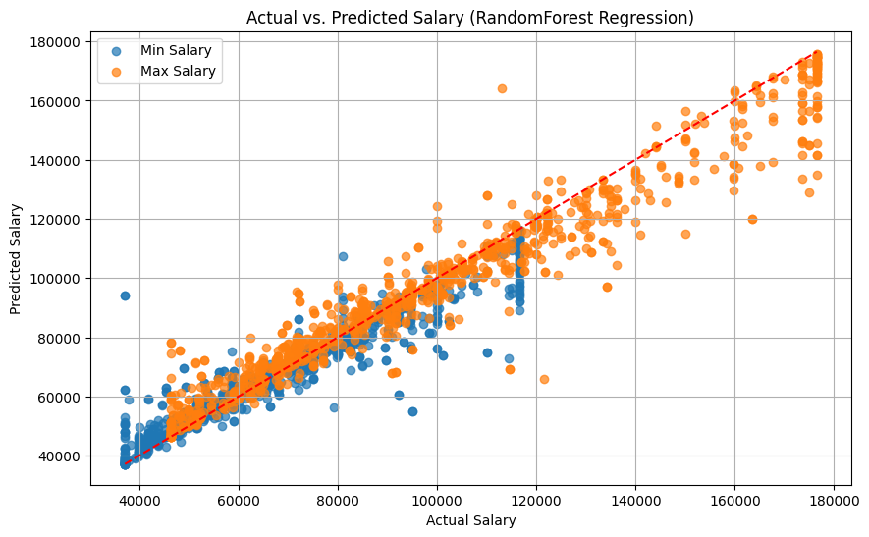
RandomForest Regression
RMSE: 8671.75
R² : 0.90

Slide 27
RandomForest Regression
The Random Forest Regression model achieved an RMSE of 8,671.75 and an R² of 0.90, indicating strong predictive performance. The predicted salaries closely align with the actual values, as shown by the tight clustering around the diagonal line. This demonstrates the model's ability to capture complex patterns and relationships in the data, significantly outperforming the Linear Regression model. However, minor deviations at higher salary ranges suggest potential for further refinement.

Slide 28
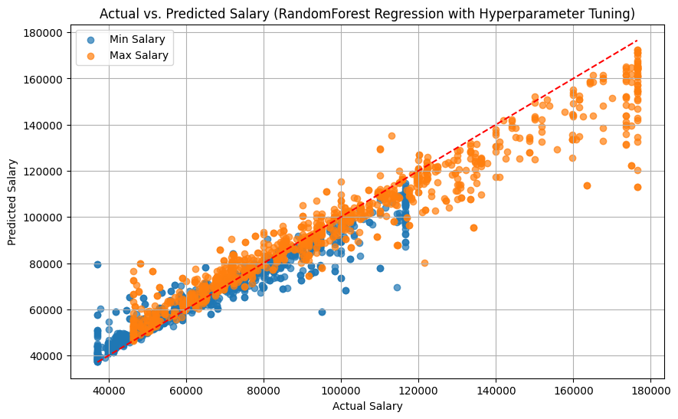
Tuned RandomForest Regression
RMSE: 8671.75
R² : 0.90

Slide 29
Tuned RandomForest Regression
The Tuned Random Forest Regression model achieved an RMSE of 9,408.59 and an R² of 0.89, indicating strong predictive performance. The predictions align well with actual salary values, though slight deviations are observed at higher salary ranges. Compared to the base model, hyperparameter tuning improved accuracy, reducing prediction errors.

Slide 30
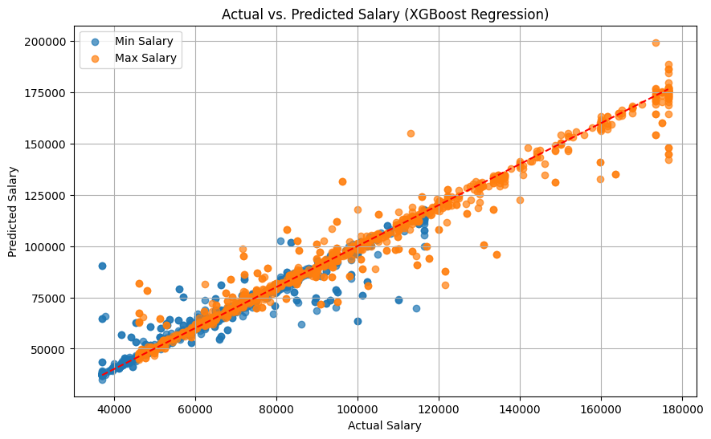
XGBoost Regression
RMSE: 6538.35
R² : 0.94

Slide 31
XGBoost Regression
The Tuned XGBoost Regression model achieved an RMSE of 6,538.35 and an R² of 0.94, indicating excellent predictive performance. The predictions closely align with the actual salary values, as shown by the tight clustering along the diagonal line. The model demonstrates improved accuracy compared to previous models, with reduced errors and better handling of higher salary ranges. This result confirms that hyperparameter tuning significantly enhanced the model's ability to capture complex patterns in the data.

Slide 32
Tuned XGBoost Regression
RMSE: 6538.35
R² : 0.94

Slide 33
Tuned XGBoost Regression
The tuned XGBoost Regression model achieved an RMSE of 6,207.89 and an R² of 0.94, indicating excellent predictive accuracy.. This model demonstrates superior performance compared to other models, capturing complex patterns effectively and minimizing prediction errors. The result confirms that hyperparameter tuning significantly enhanced the model's ability to generalize, making it the most reliable model for salary prediction in this project.

Slide 34
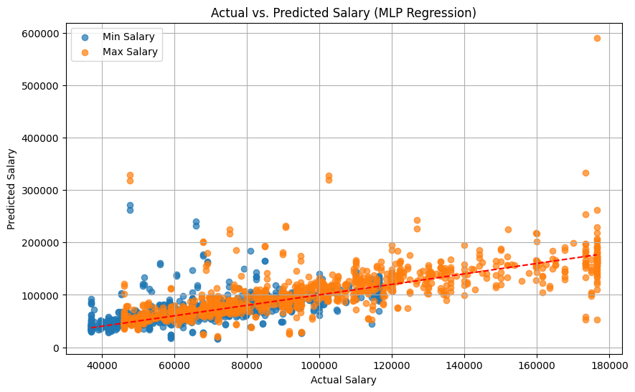
MLP Regression
RMSE: 28372.39
R² : 0.01

Slide 35
MLP Regression
The MLP Regression model performed poorly, with an RMSE of 28,372.39 and an R² of 0.01, indicating almost no predictive power. The predictions are widely scattered and deviate significantly from the actual values, especially at higher salary ranges. This suggests that the MLP model struggled to capture the underlying patterns in the data, potentially due to insufficient tuning, overfitting, or the complexity of the data not being well-suited for this model architecture. Further optimization or reconsidering model selection is recommended.

Slide 36
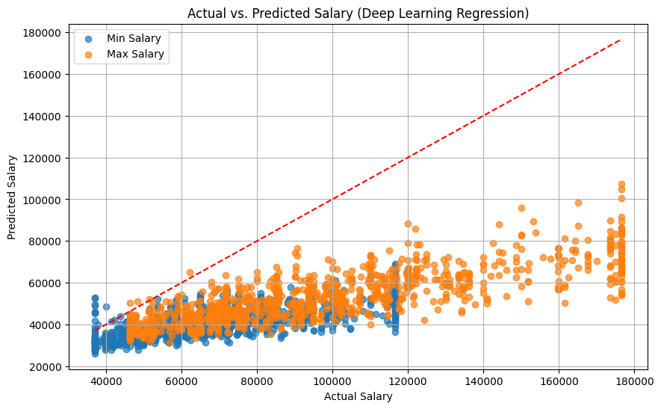
Deep Learning Model
RMSE: 43342.26
R² : -1.29

Slide 37
Deep Learning Model
The Deep Learning Model performed poorly, with an RMSE of 43,342.26 and a negative R² of -1.29, indicating that the model performs worse than simply predicting the mean salary. The predictions are highly clustered and fail to capture the upward trend in actual salaries, significantly underestimating higher salary values.

Slide 38
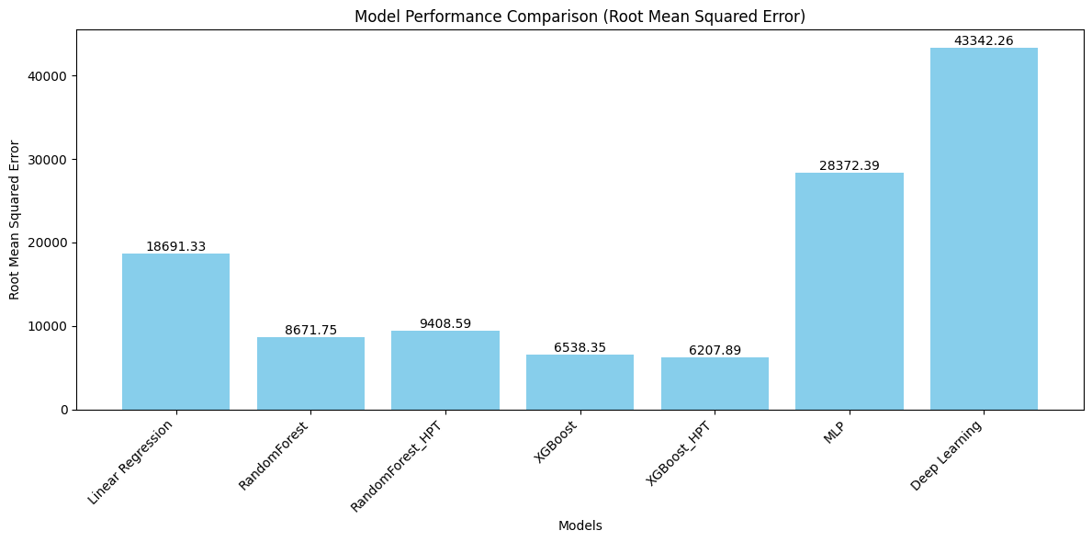
Performance Evaluation (RMSE)

Slide 39
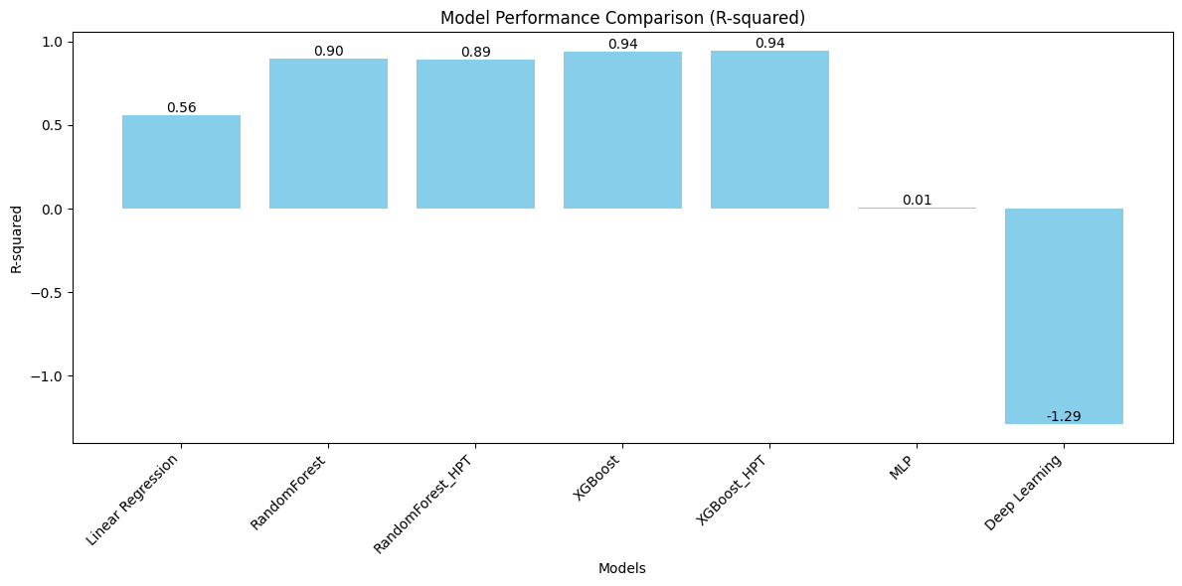
Performance Evaluation (R²)

Slide 40
Performance Evaluation
The model comparison shows that the XGBoost model with hyperparameter tuning (XGBoost_HPT) achieved the best performance, with the lowest RMSE of 6,207.89 and the highest R² of 0.94, indicating high prediction accuracy and low error. The untuned XGBoost model follows closely.

Slide 41
Model Selection Conclusion
Given the evaluation results, the XGBoost model with hyperparameter tuning (XGBoost_HPT) is the most suitable choice for this salary prediction task. It strikes the best balance between accuracy and robustness, outperforming all other models in both R² and RMSE metrics. Now that the model has been selected, SHAP or SHapley Additive exPlanations can be used to improve or enhanced the model.

Slide 42
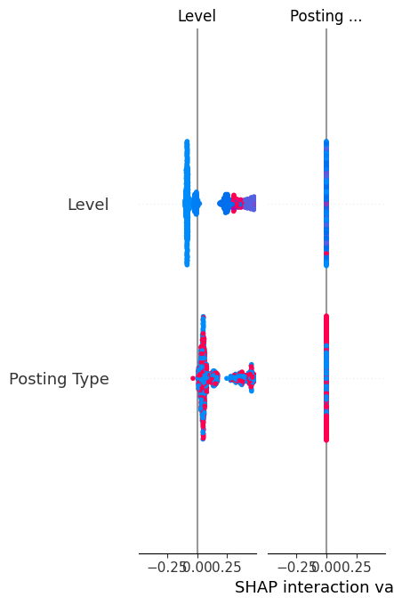
SHAP (SHapley Additive exPlanations)
The SHAP interaction plot shows that 'Level' significantly impacts salary predictions, while 'Posting Type' has minimal influence. This suggests that 'Posting Type' could be considered for removal or transformation to simplify the model without compromising accuracy.

Slide 43
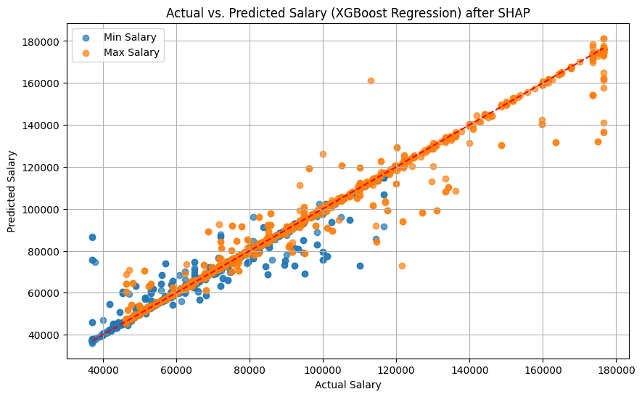
Tuned XGBoost Regression (new)
RMSE: 6135.28
R² : 0.95

Slide 44
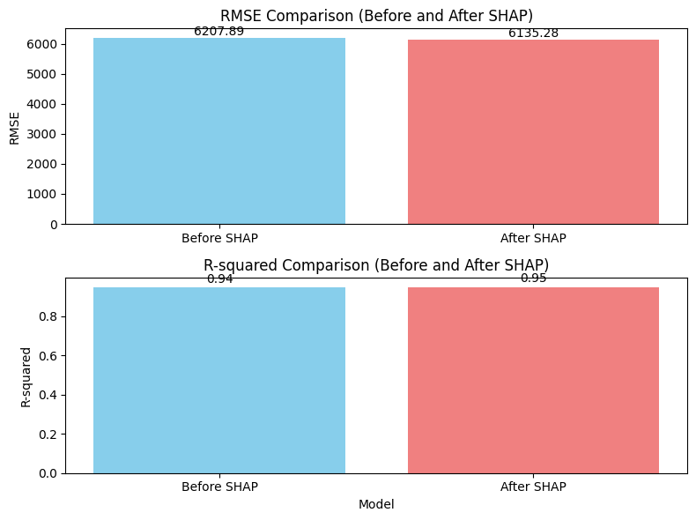
Tuned XGBoost Regression (new)

Slide 45
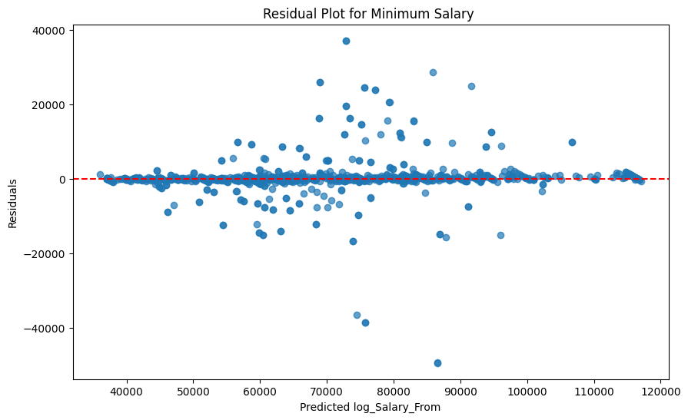
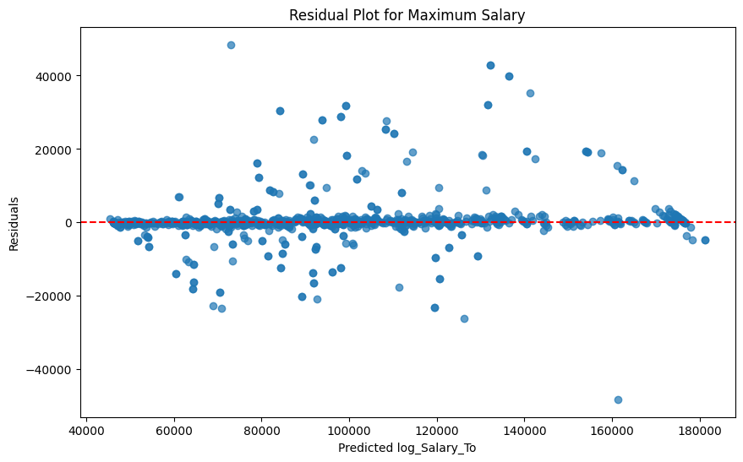
Residual Analysis
The residual plots for both minimum and maximum salary predictions show that residuals are mostly centered around zero, suggesting the model generally performs well.

Slide 46
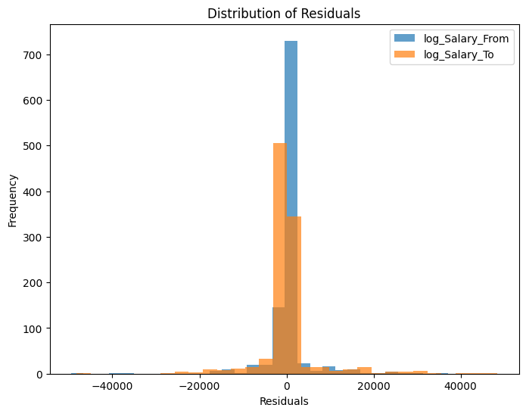
Residual Analysis
The distribution plot of residuals for both minimum and maximum salary shows that most residuals are centered around zero, indicating that the model's predictions are generally accurate. The residuals exhibit a relatively normal distribution, suggesting that the model does not have systematic bias.

Slide 47
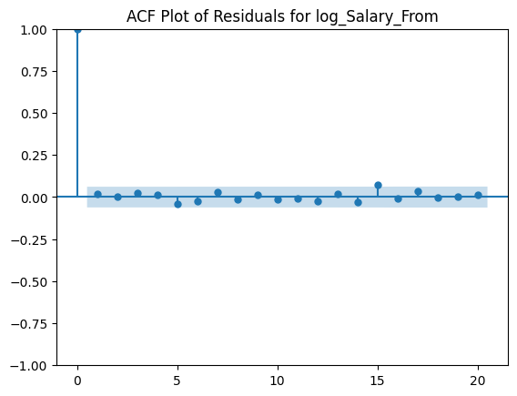
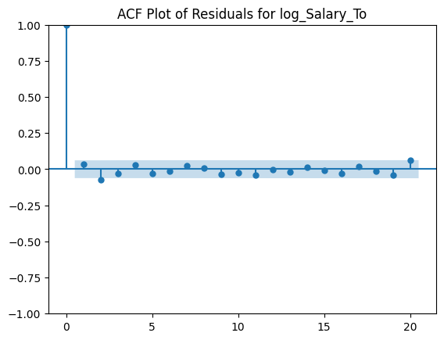
ACF Plot of Residuals
The ACF (Autocorrelation Function) plots for both minimum and maximum salary residuals show that autocorrelations quickly drop to zero after the first lag and remain within the confidence bounds. This indicates that there is no significant autocorrelation present in the residuals, suggesting that the model's residuals are independent and there is no pattern left unexplained by the model.

Slide 48
Tuned XGBoost Regression (new)
After applying SHAP-based feature refinement, the tuned XGBoost model showed significant improvement in performance. Initially, the model achieved an RMSE of 6,207.89 and an R² of 0.94, indicating strong predictive accuracy. However, after refining features based on SHAP insights, the model's performance further improved, reducing the RMSE to 6,135.28 and increasing the R² to 0.95, signifying an even stronger fit to the data.

Slide 49
Tuned XGBoost Regression (new)
Residual analysis supported this improvement, as the residuals post-SHAP refinement were more tightly clustered around zero, with reduced variance and no noticeable autocorrelation. This confirms that the model's errors became more consistent and unbiased. Additionally, the ACF plots indicated no significant autocorrelation in residuals, and the residual distribution centered more closely around zero, further validating the model's reliability.
Overall, the slight yet meaningful performance enhancement confirms that removing less impactful features identified through SHAP not only simplified the model but also increased its predictive accuracy and efficiency.

Slide 50
Recommendations
Deploy the Tuned XGBoost Model
The tuned XGBoost model (after SHAP refinement) demonstrated the best performance with an RMSE of 6,135.28 and R² of 0.95, indicating excellent accuracy and robustness.
Deploy this model as the primary solution for predicting salary ranges in job listings.
2. Regularly Update and Re-train the Model
Salary trends and job market conditions are dynamic and can change over time.
Schedule regular updates and re-training of the model with new job listing data to maintain accuracy and relevance.

Slide 51
Recommendations
3. Create Salary Benchmark Reports
Provide detailed reports highlighting salary ranges by job title, level, and industry to aid in strategic hiring decisions.
Automate the generation of salary benchmark dashboards for stakeholders to easily access and interpret salary trends.
4. Monitor Model Performance Post-Deployment
Establish a monitoring dashboard to track prediction accuracy over time and trigger re-training as needed.
Regularly assess model performance using new data and metrics like RMSE and R² to detect any drift.

Slide 52
Recommendations
5. Leverage Predictive Insights for Budget Planning
Use predictive models like the tuned XGBoost to forecast future salary trends and plan recruitment budgets accordingly.
Allocate resources strategically to attract and retain top talent within expected salary ranges.
6. Optimize Talent Retention Strategies
Utilize model predictions to analyze and forecast salary progression within career levels, ensuring consistent and motivating pay increases.
Offer salary growth pathways for employees to encourage long-term retention.

Slide 53
Recommendations
7. Use Data Transparency to Enhance Hiring
Share salary ranges openly in job postings to attract qualified candidates and reduce negotiation hurdles.
Promote salary transparency within the organization to foster trust and equality.
8. Customize Salary Offers Based on Job Levels and Experience
Recognize that higher levels and career stages demand higher salary ranges, as shown by model insights.
Ensure that compensation packages reflect experience, skills, and industry demands to reduce turnover.

Slide 54
Recommendations
9. Prepare for Salary Negotiations
Equip HR teams with predictive insights to better navigate salary negotiations with candidates and employees.
Base offers on objective data rather than intuition, leading to more balanced and justified negotiations.

Slide 55
Thank You!

